Slide 1


Cyber Bullying Detection On Social Media Using Machine Learning
Guided By:
Sugantha Lakshmi.R AP/CSE ,
Kings College Of Engineering.
Team Members
Bakiya Lakshmi A 821119104009
Nandhini J 821119104029
Suruthi S 821119104501

Slide 2
ABSTRACT
Now a days people use social media to create ,share and exchanges information and ideas like Instagram,Facebook,Twitter etc. As the technology advances the cyber bullying is getting enhanced. Now a days online harassment ,defame a person with bad words in fake id is a common problem and happens often in social media that leads to several instances .In order to address this problem we are proposing a framework focused on machine learning to analysis emotional content of text and prevents sharing of harassment words. We use dataset of online conversation from Twitter, Wikipedia and kaggle to train and test the model uses Natural Language Processing technique such as sentiment analysis and topic modeling to identify patterns of abusive language and offensive content. The models accuracy is evaluate using precision, recall and F1 score and is found to be effective in detecting cyber bullying with an accuracy of 90%.The results suggest that emotion analysis can be an effective tool for detecting cyber bullying and may help identify and prevent harmful behavior online.

Slide 3
INTRODUCTI0N
There have been several instances of harassment and abuse on Twitter in Tamil Nadu, India. Here are a few examples of famous harassment incidents on the platform:
In 2019, a Tamil Nadu-based businessman named Kathiresan was targeted with abuse and threats on Twitter after he criticized the ruling party in the state. Kathiresan received hundreds of hateful messages, and his phone number and address were shared online. He filed a complaint with the police, and several individuals were arrested in connection with the harassment.
The origin of cyberbullying can be traced back to the rise of the internet and social media in the 1990s and early 2000s. As more people began using online platforms to communicate and connect with others, some individuals began using these tools to harass, intimidate, or humiliate others.
Early forms of cyberbullying included sending threatening or insulting emails, creating fake social media profiles to impersonate or mock others, and spreading rumors or lies online. As technology evolved and social media platforms became more popular, the scope and intensity of cyberbullying also grew.

Slide 4
INTRODUCTI0N
Today, cyberbullying can take many forms, including sending hateful messages on social media, sharing embarrassing photos or videos without someone's consent, posting hurtful comments on public forums or chat rooms, and even using video game chat rooms to harass other players.
The root causes of cyberbullying are complex and multifaceted, and may include factors such as anonymity, social isolation, and a desire for power or control. It's important to recognize that cyberbullying is a serious issue that can have harmful and long-lasting effects on individuals and communities.

Slide 5
OBJECTIVE
The objective of using machine learning for cyber bullying detection on social media is to develop an algorithm that can identify and flag potentially harmful or offensive content in real-time.
PREVENTION:
promoting positive online behavior and values.
SAFE ENVIRONMENT:
Its aim to create safe and supportive environment which individuals feels comfortable.
Overall, the objective of a cyberbullying project should be to create a culture of respect, empathy, and inclusion, in which individuals feel safe and supported and can thrive without fear of harassment or bullying.

Slide 6
LITERATURE REVIEW
Year | Author | Title | Algorithm Methodological & Techniques | Inference
2022 | V. Banerjee, J. Telavane, P. Gaikwad, and P. Vartak | Detection of Cyberbullying Using Deep Neural Network | Deep learning | More complex not proper preprocessing technique.
2021 | S. Agrawal and A. Awekar | Machine learning for detecting cyber bullying across multiple social media platforms | Machine learning | By using real world dataset improve accuracy.

Slide 7
LITERATURE REVIEW
Year | Author | Title | Algorithm Methodological & Techniques | Inference
2020 | A. Mangaonkar, A. Hayrapetian, and R. Raje | Collaborative detection of cyberbullying behavior in Twitter data | Machine learning, Collabarative technique | Through collective knowledge improve scalability and efficiency.
2019 | R. Zhao, A. Zhou, and K. Mao | Automatic detection of cyberbullying on social networks based on bullying features. | Mining technique Clustering, Classification. | About discovering patterns, trends, Insights from large datasets.

Slide 8
LITERATURE REVIEW
Year | Author | Title | Algorithm Methodological & Techniques | Inference
2018 | J. Yadav, D. Kumar, and D.Chauhan | Cyberbullying Detection using Pre-Trained BERT Mode | NDL algorithm, DL algorithm | Over fitting and Data quality is less.

Slide 9
EXSITING SYSTEM
Cyberbullying detection on social media using artificial intelligence (AI) and machine learning (ML) is an emerging field that aims to automatically identify and flag potentially harmful content in online platforms. AI and ML algorithms can be trained to detect patterns in social media data, such as the use of abusive language, threatening messages, or images that may be harmful to individuals or groups.
The process of cyberbullying detection using AI involves collecting and analyzing large amounts of social media data, identifying keywords and phrases associated with cyberbullying, and using natural language processing (NLP) techniques to understand the context of the content. The algorithms can also use behavioral analysis to detect patterns of abusive behavior over time, such as repeated instances of online harassment.
Once potentially harmful content is identified, social media platforms can take action to remove the content, warn the user who posted it, or take other measures to prevent further harm. AI-powered cyberbullying detection can help social media platforms to proactively identify and address cyberbullying, which can be difficult to monitor and control manually due to the sheer volume of social media content.
Overall, the use of AI and ML for cyberbullying detection on social media holds great potential to improve the safety and well-being of individuals online. However, it is important to ensure that these technologies are used ethically and responsibly, with appropriate safeguards in place to protect user privacy and prevent the misuse of these tools.

Slide 10
EXSITING SYSTEM
There are many existing systems in cyber bulling detection on social media and have a following issues:
ACCURACY:
By using Naive Bays algorithm got 85% accuracy.
By using SVM algorithm got 85 to 90% accuracy.
Accuracy depends on dataset.
ANONYMITY:
Huge peoples are in social media its encourage the bullies without any fear do harassment ,defame others with fake id.
To search the victim others also be affected.
OVERFITTING:
Training dataset over close to features will affect the prediction.

Slide 11
EXSITING SYSTEM
LESSFITTING:
Less datasets to be trained doesn’t provide a scalability.
ALGORITHM UTILTY:
By using more algorithms increases the accuracy level.
Natural Language Processing helps for feature extraction.
FALSE POSITIVES FALSE NEGATIVES:
It is a common problem in machine learning like any ML model identifying non-cyberbullying behavior as cyberbullying .
False negatives (failing to identify cyberbullying behavior). These errors can have negative consequences, such as wrongly accusing someone of cyberbullying or failing to identify instances of cyberbullying that are occurring.

Slide 12
PROPOSED METHOD
The proposed methodology for cyber bullying detection on social media involved data-driven approach using machine learning. The process begins with collecting a diverse dataset of user interactions from social media platforms. This data is then preprocessed to remove noise and standardize the text. Relevant features, such as word frequency and sentiment analysis, are extracted from the preprocessed data. The collected data is labeled as either cyber bullying or non-cyber bullying using manual or automated techniques. Machine learning algorithms are trained on the labeled data, using the extracted features as input. The trained model is evaluated using standard metrics, and then integrated into a real-time system capable of monitoring and detecting instances of cyber bullying. Continuous learning and user feedback are utilized to refine and improve the system over time, ensuring its effectiveness in identifying .

Slide 13
PROPOSED SYSTEM
DATA COLLECTION:
Data’s are collected from real time such as twitter ,Wikipedia ,kaggle.
Do the preprocessing work effectively.
USING COMBINATIONS OF ALGORITHM:
By using various algorithm such as Support Vector Machine(SVM),Random forest, Logistic regression using Natural Language Processing(NLP) technique provides the accuracy level.
Decision tree helps to make prediction accurately.
FEATURE EXTRACTION:
It analyze the raw data using patterns, relationships and relevant characteristics in textual message.
The feature will be extracted by Bag of words, Term frequency, Inverse document frequency and word2vec models.

Slide 14
PROPOSED SYSTEM
SENTIMENT ANALYSIS:
It is trained by labeled data that will classified into positive ,negative and neutral categories.
By understanding the emotions expressed in a message, it is possible to identify instances of cyberbullying.
BEHAVIORAL ANALYSIS:
It focuses on identifying patterns of behavior that are associated with cyberbullying through analyzing the content of individual messages.
Clustering techniques can group users who exhibit similar behavior, such as posting aggressive or offensive content.
PRECISION AND RECALL :
Precision and recall are measures of a model's performance in identifying positive and negative instances.
Precision measures the proportion of positive predictions that are correct, while recall measures the proportion of actual positive instances that are correctly identified by the model.

Slide 15
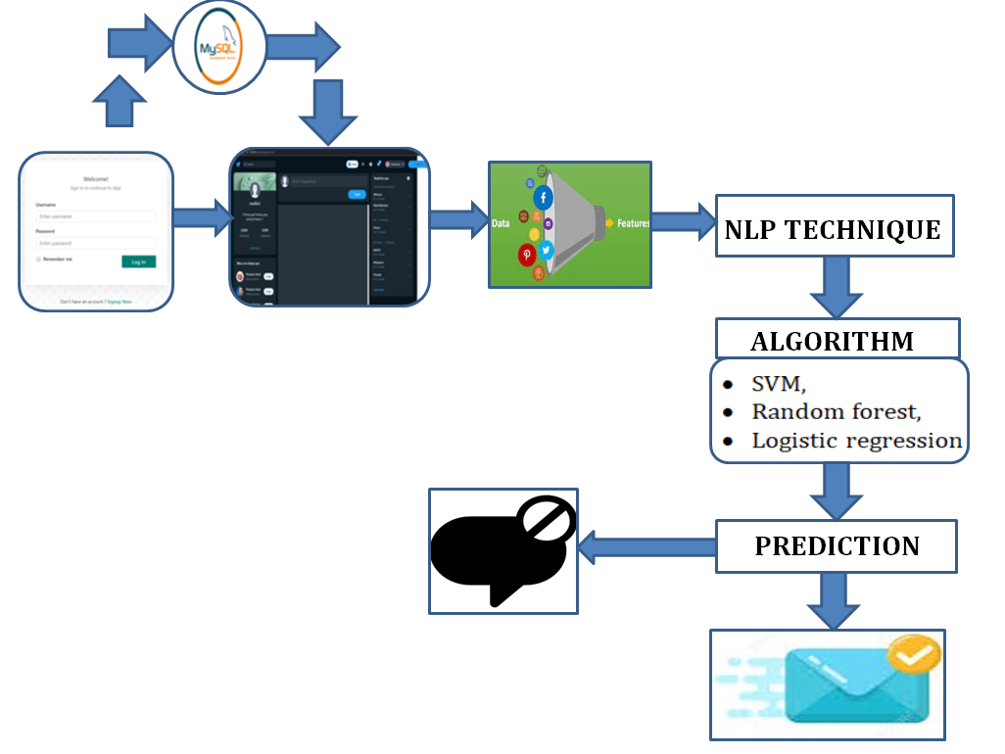
ARCHITECTURE DIAGRAM

Slide 16
SYSTEM REQUIREMENTS
H/W SYSTEM CONFIGURATION:
Processor - Pentium –IV
RAM - 4 GB (min)
Hard Disk - 20 GB
S/W SYSTEM CONFIGURATION:
Operating System : Windows 7 or 8
Front End : Python Idle , Flask

Slide 17
MODULE LIST
DATA COLLECTION :
Data’s are collected from real time such as twitter ,Wikipedia ,kaggle.
It is an labeled dataset used to classify cyber bullying or not.
47693 data’s were trained in this framework.
DATA PREPROCESSING :
In ML most of work is in preprocessing.
Another from dataset it is way to increase the accuracy.
Some preprocess steps are Preprocessing is an essential step in machine learning that involves preparing and transforming the raw data into a suitable format for the learning algorithm. Preprocessing helps to improve the quality of the data, remove noise, handle missing values, and make the data compatible with the chosen machine learning 17 model. Here are some common preprocessing steps:

Slide 18
MODULE LIST
1. DATA CLEANING:
HANDLING MISSING DATA:
Decide on a strategy to deal with missing values, such as imputation (replacing missing values with estimated values) or removing instances with missing data.
Handling outliers: Identify and handle outliers, which are data points significantly different from other observations, by either removing them or transforming them.
2. DATA TRANSFORMATION:
FEATURE SCALING:
Scale numerical features to a standard range (e.g., between 0 and 1) to ensure that features with different scales do not dominate the learning process. Common scaling techniques include normalization (min-max scaling) and standardization (zscore scaling).
FEATURE ENCODING:
Convert categorical features into a numerical representation since most machine learning algorithms work with numerical data. Common techniques include one-hot encoding, label encoding, or ordinal encoding.

Slide 19
FEATURE ENGINEERING:
Create new features or transform existing features to extract more meaningful information that can improve the learning process. This could involve techniques such as polynomial features, logarithmic transformations, or interaction terms.
DIMENSIONALITY REDUCTION:
FEATURE SELECTION:
Choose the most relevant features that contribute the most to the prediction task, removing irrelevant or redundant features. This helps to reduce overfitting. 18 • Feature extraction: Transform the high-dimensional data into a lower-dimensional space while preserving the most important information. Techniques like Principal Component Analysis (PCA) or Singular Value Decomposition (SVD) are commonly used for feature extraction.

Slide 20
HANDLING IMBALANCED DATA:
In scenarios where the classes in the target variable are imbalanced (i.e., one class has significantly more instances than the other), techniques such as oversampling the minority class or under sampling the majority class can be applied to balance the dataset.
SPLITTING DATA:
Divide the dataset into training, validation, and testing sets. The training set is used to train the model, the validation set is used to fine-tune hyperparameters, and the testing set is used to evaluate the model's performance on unseen data.
These preprocessing steps are not exhaustive, and the specific techniques used may vary depending on the nature of the data, the problem domain, and the requirements of the machine learning algorithm being used.

Slide 21
MODULE LIST
NLP PROCESSING:
FEATURE EXTRACTION
BAG OF WORDS MODEL:
In this model, a piece of text is represented as a "bag" (multiset) of its words, disregarding grammar and word order but keeping track of the frequency of each word.
Unigram model where single words and Bigram model uses two words and N-gram model is the generalized mode.
TF-IDF MODEL:
Term frequency(Tf) is a calculation of frequency of a word in a document. It is measured as chance of finding a text word inside a document.
Inverse document frequency (Idf) shows how frequent or rare a word is throughout the corpus. It is used to identify rare words in corpus. Idf value is higher for rarer words.

Slide 22
MODULE LIST
WORD2VEC:
These vector representations capture the semantic and syntactic relationships between words, making them useful for a wide range of natural language processing tasks.
Continuous bag of words (CBOW) and skip-gram. In CBOW, the algorithm predicts the target word based on its context, whereas in skip-gram, it predicts the context words based on the target word. Both architectures have their advantages and disadvantages depending on the specific task and dataset.

Slide 23
MODULE LIST
MODEL SELECTION
ALGORITHMS
SUPPORT VECTOR MACHINE(SVM):
Support Vector Machines (SVMs) are a popular algorithm in machine learning used for classification and regression analysis.
The hyperplane is chosen such that it maximizes the margin, which is the distance between the hyperplane and the closest data points from each class.
LOGISTIC REGRESSION:
Logistic regression is a statistical technique used for modeling the probability of a binary response variable based on one or more predictor variables.
The sigmoid function maps any input value to a value between 0 and 1, which can be interpreted as the probability of the response variable taking on a certain value.
RANDOM FOREST:
Random forest is a popular machine learning algorithm used for classification, regression, and other tasks. It is an ensemble method that combines multiple decision trees to make a final prediction.
In a random forest, multiple decision trees are built on different subsets of the training data, with different sets of randomly selected features.

Slide 24
MODULE LIST
This helps to reduce over fitting and increase the generalization performance of the model.
MODEL DEPLOYMENT:
It’s a developed by a python program and Jupiter file deployed as an JSON file.
Web page developed with basic HTML and CSS.

Slide 25
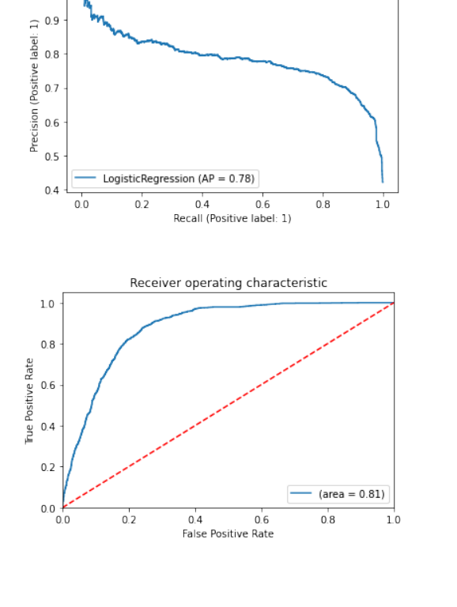
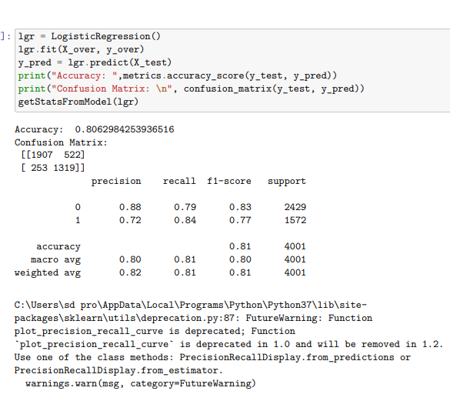
PERFORMANCE EVALUVATION
LOGISTIC REGRESSION

Slide 26
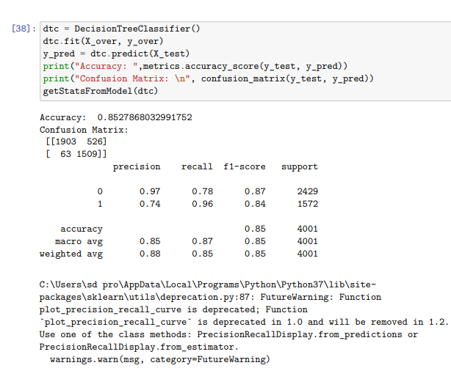
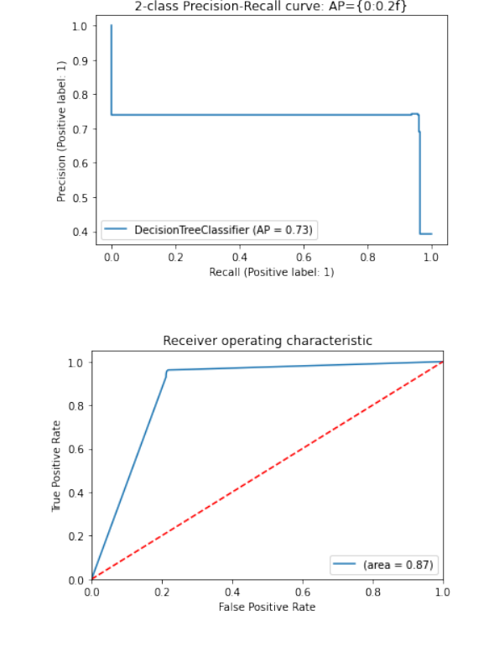
PERFORMANCE EVALUVATION
DESCISION TREE

Slide 27
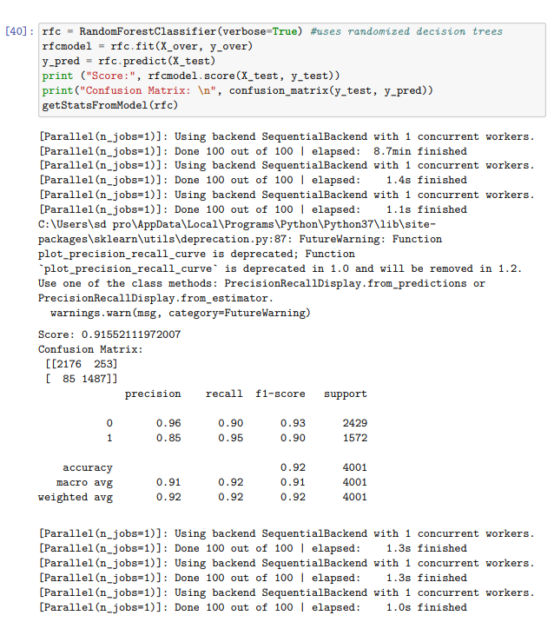
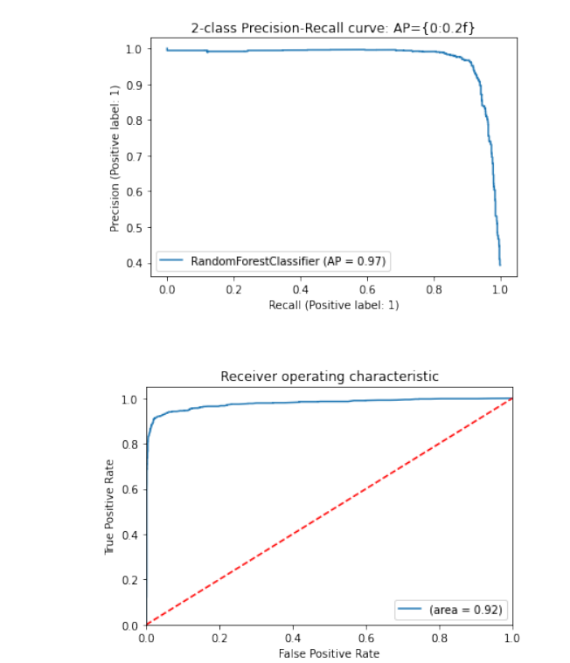
PERFORMANCE EVALUVATION
RANDOM FOREST

Slide 28
CONCLUSION
In conclusion, machine learning can be a powerful tool for detecting cyberbullying on social media platforms. By training models on large datasets of labeled examples, machine learning algorithms can learn to automatically identify patterns in text and detect instances of cyberbullying with high accuracy. The benefits of using machine learning for cyberbullying detection include faster and more efficient identification of instances of cyberbullying, which can help social media platforms take action to protect their users. Overall, machine learning has the potential to play an important role in addressing the problem of cyberbullying on social media, but it should be used as part of a comprehensive approach that includes education, community engagement, and policy changes to create a safer and more respectful online environment.

Slide 29
FUTURE ENHANCEMENT
Plan to attach framework with Twitter and provide non cyber bullying platform.
Plan to establish non cyber bulling positive social media application.

Slide 30
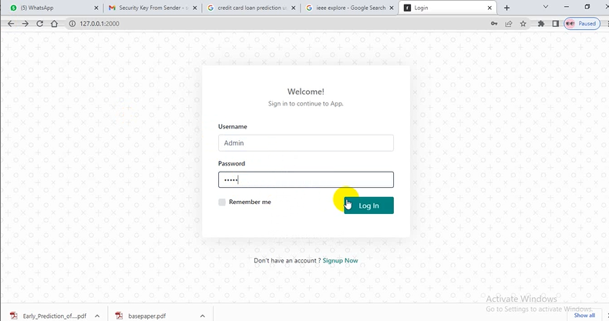
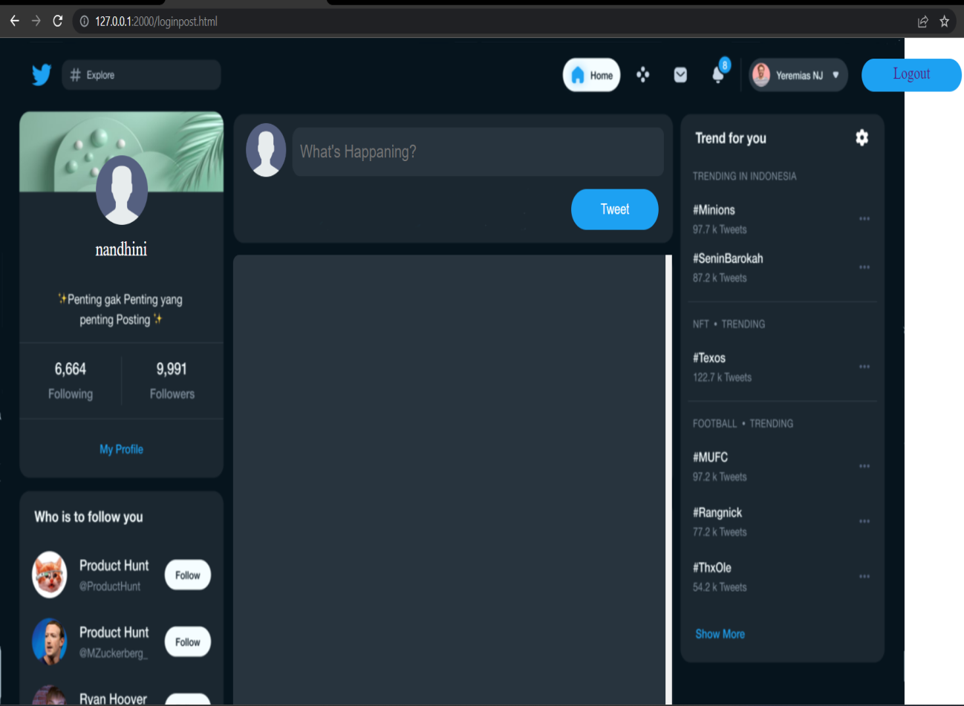
OUTPUT

Slide 31


PROGRAMS SAMPLES

Slide 32
REFERENCE
[1] P. Galán-García, J. G. de la Puerta, C. L. Gómez, I. Santos, and P. G. Bringas, “Supervised machine learning for the detection of troll profiles in twitter social network: Application to a real case of cyberbullying,” 2022, doi: 10.1007/978-3-319-01854-6_43.
[2]A. Mangaonkar, A. Hayrapetian, and R. Raje, “Collaborative detection of cyberbullying behavior in Twitter data,” 2019, doi: 10.1109/EIT.2015.7293405.
[3] R. Zhao, A. Zhou, and K. Mao, “Automatic detection of cyberbullying on social networks based on bullying features,” 2020 doi: 10.1145/2833312.2849567.
[4] V. Banerjee, J. Telavane, P. Gaikwad, and P. Vartak, “Detection of Cyberbullying
Using Deep Neural Network,” 2019, doi: 10.1109/ICACCS.2019.8728378.
[5] K. Reynolds, A. Kontostathis, and L. Edwards, “Using machine learning to detect cyberbullying,” 2018, doi: 10.1109/ICMLA.2011.152.

Slide 33
THANK YOU

